Slide 1
Data science
UNIT-I
Similarity and Dissimilarity measures

Slide 2
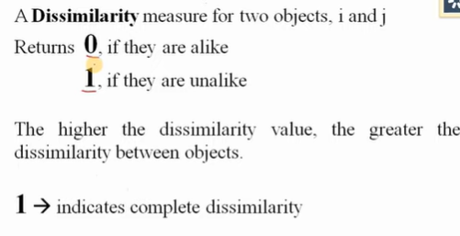
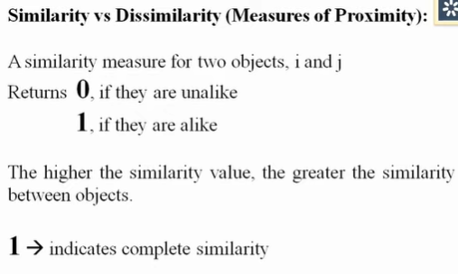
Similarity and Dissimilarity
Similarity
Proximity: refers to a similarity or dissimilarity

Slide 3

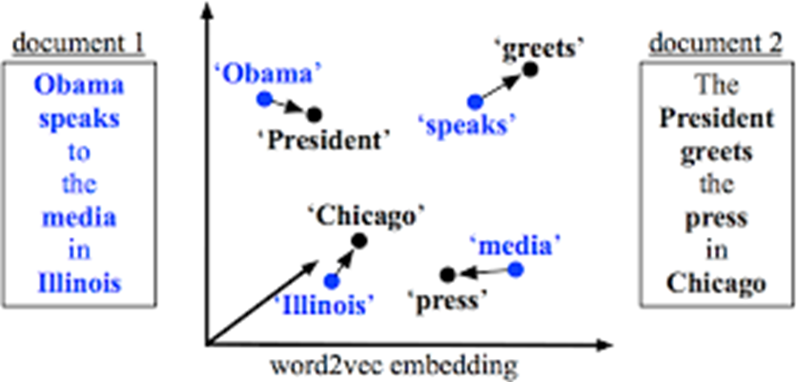
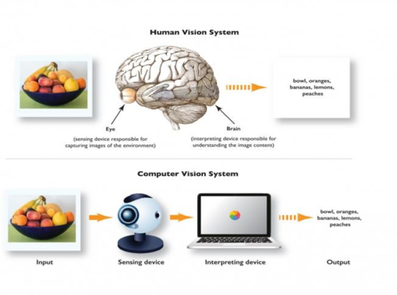
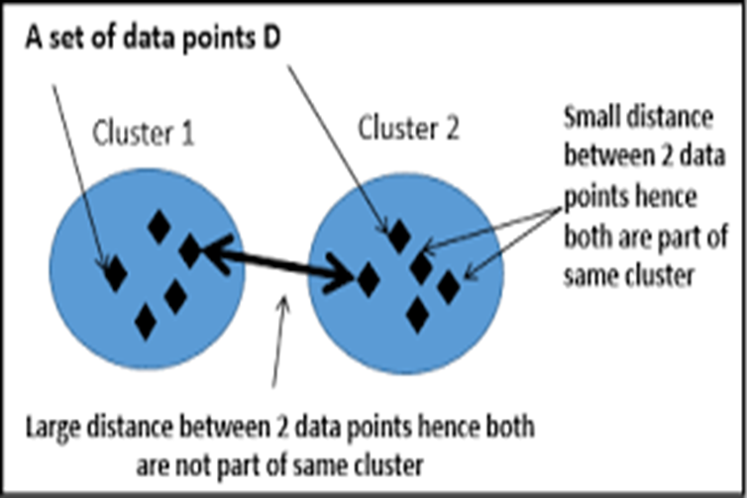
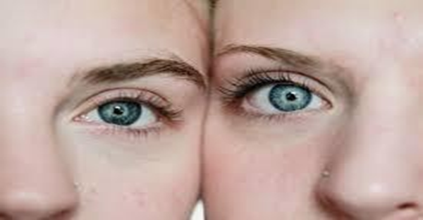
Similarity and Dissimilarity Applications:
Web search
Computer vision:
Image Processing
Natural language processing
Clustering outliers

Slide 4
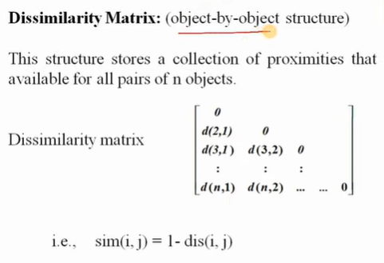
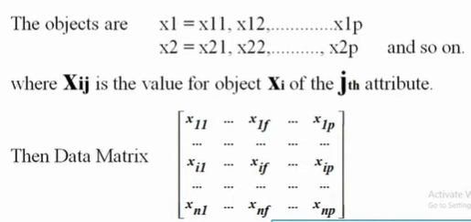
Data Matrix and Dissimilarity Matrix
Data Matrix

Slide 5
Distance measures on Numeric Data: Minkowski Distance
Minkowski distance: A popular distance measure
  where i = (x_{i1}, x_{i2}, …, x_{ip}) and j = (x_{j1}, x_{j2}, …, x_{jp}) are two p-dimensional data objects, and h is the order (the distance so defined is also called L-h norm)
Properties
  d(i, j) > 0 if i ≠ j, and d(i, i) = 0 (Positive definiteness)
  d(i, j) = d(j, i) (Symmetry)
  d(i, j) ≤ d(i, k) + d(k, j) (Triangle Inequality)
A distance that satisfies these properties is a metric

Slide 6

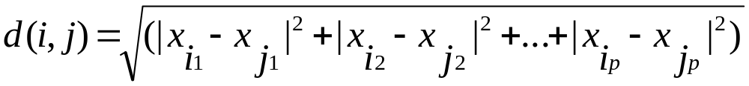
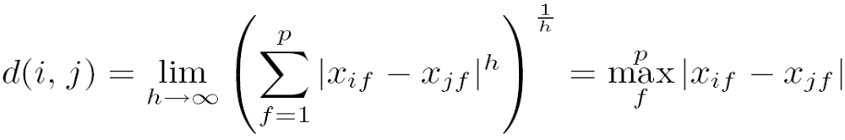
Special Cases of Minkowski Distance
h = 1: Manhattan (city block, L₁ norm) distance
  E.g., the Hamming distance: the number of bits that are different between two binary vectors
h = 2: (L₂ norm) Euclidean distance
h → ∞. “supremum” (L_{max} norm, L∞ norm) distance.
  This is the maximum difference between any component (attribute) of the vectors

Slide 7
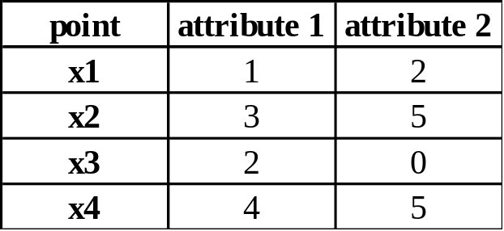
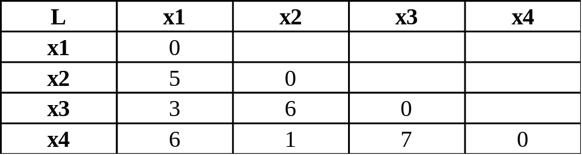
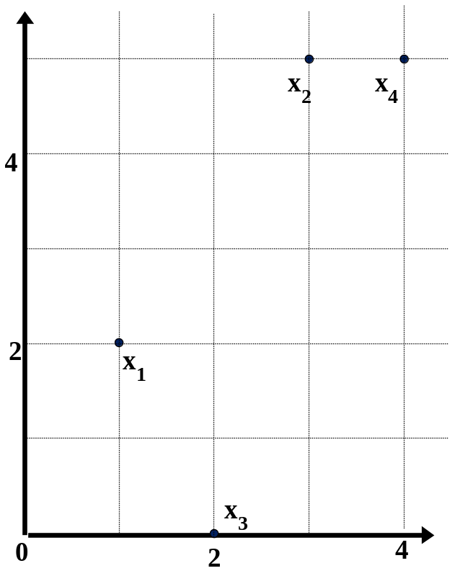
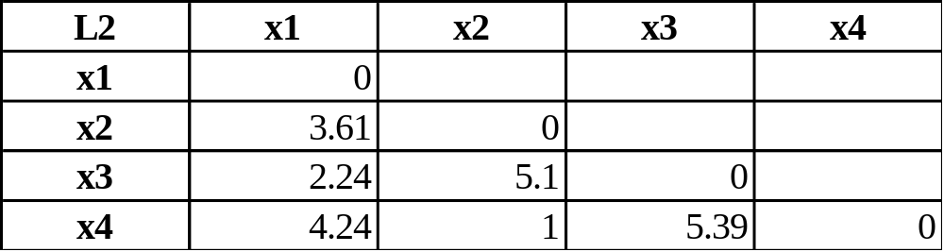
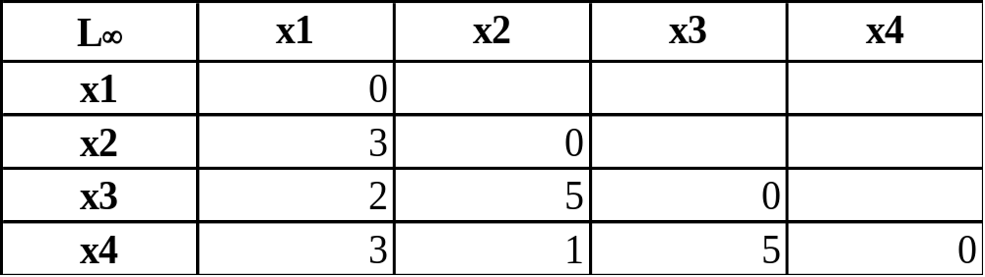
Example: Minkowski Distance
Dissimilarity Matrices
Manhattan (L₁)
Euclidean (L₂)
Supremum

Slide 8
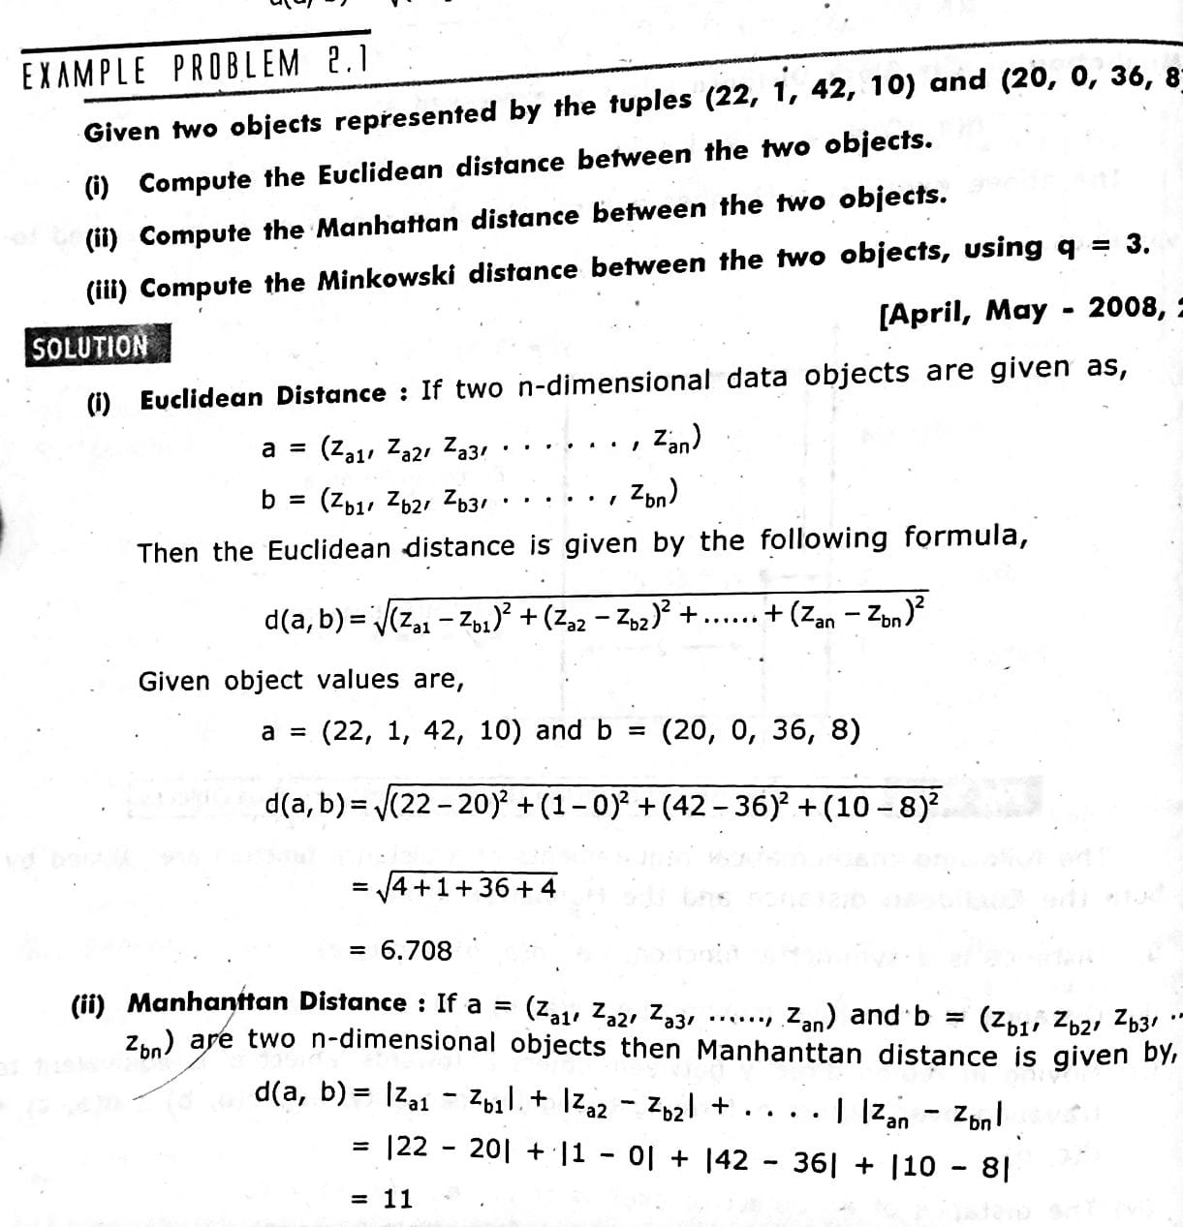
Example : Numeric attribute: Find the distances

Slide 9
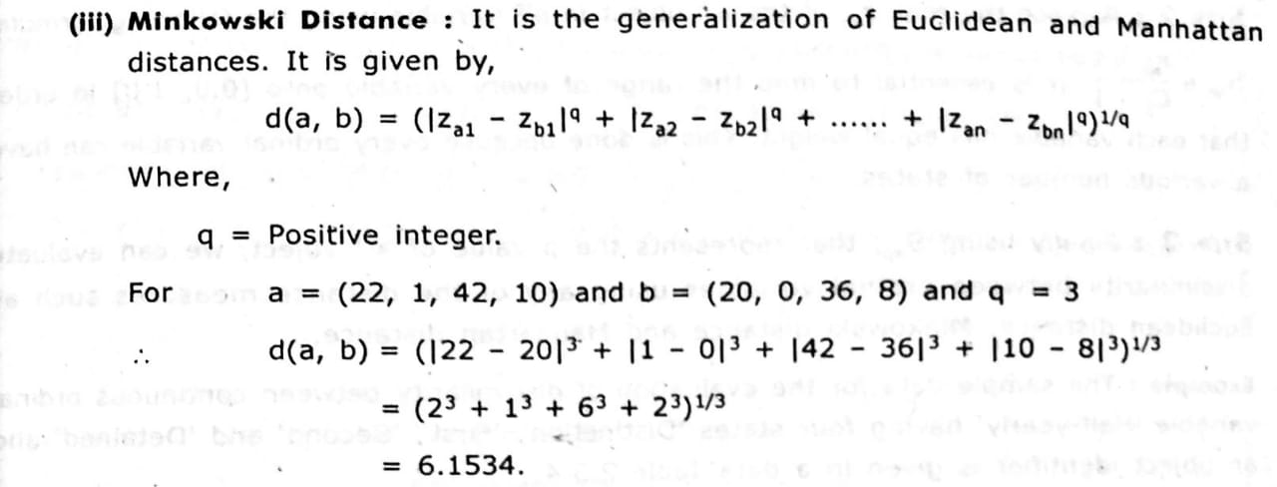
Example: Numeric Attribute

Slide 10
Similarity / Proximity Measures
Nominal attributes
Binary attributes
Ordinal attributes
Numeric attributes 1. Scaled 2. Ratio
Mixed attributes

Slide 11
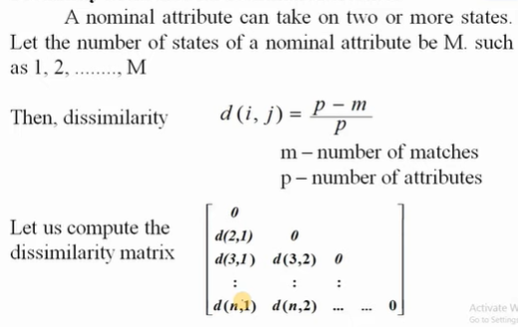
Proximity Measure for Nominal Attributes

Slide 12
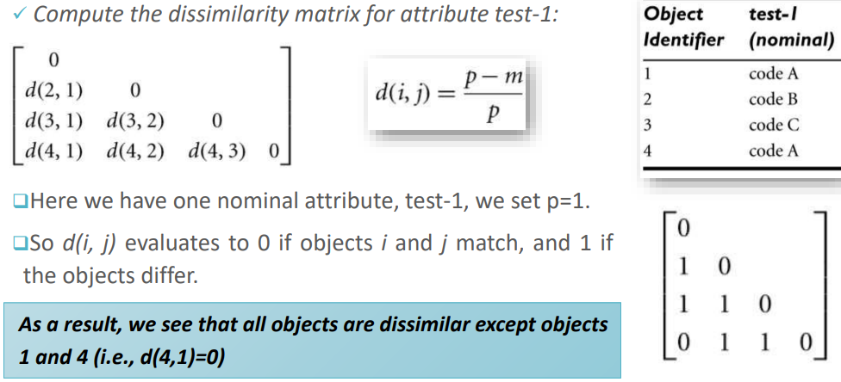
Example : find dissimilarity of given data

Slide 13
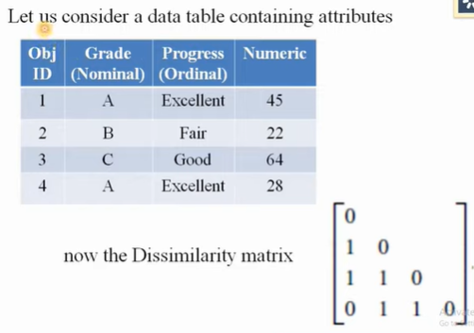
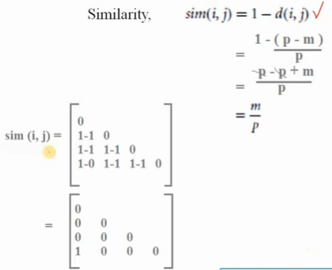
Example: Finding Similarity matrix for Nominal attribute

Slide 14
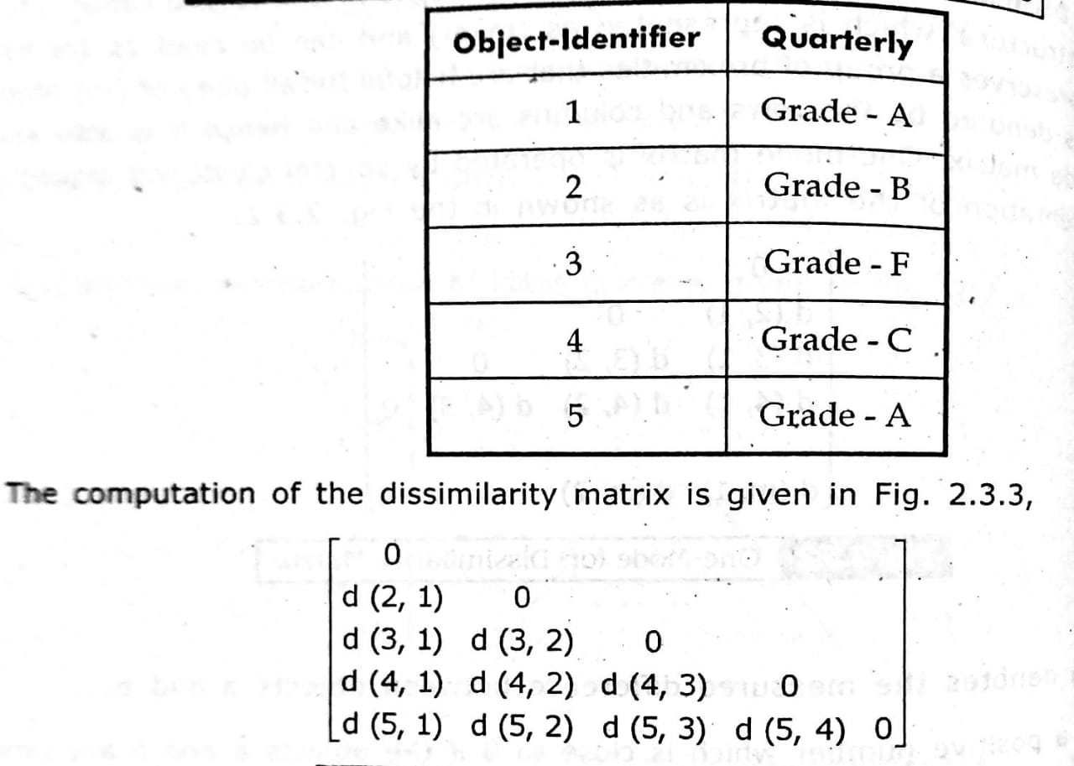
Example: Nominal attribute

Slide 15
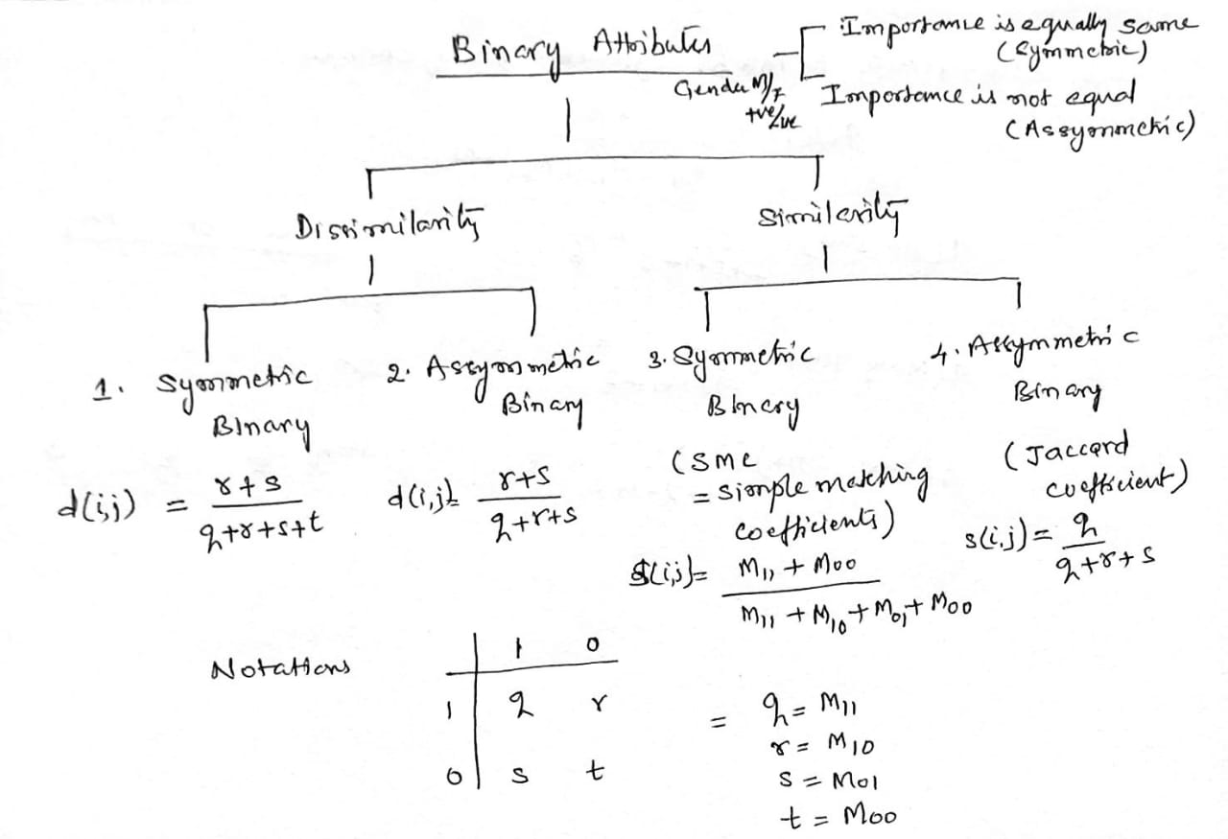
Proximity Measure for Binary Attributes

Slide 16
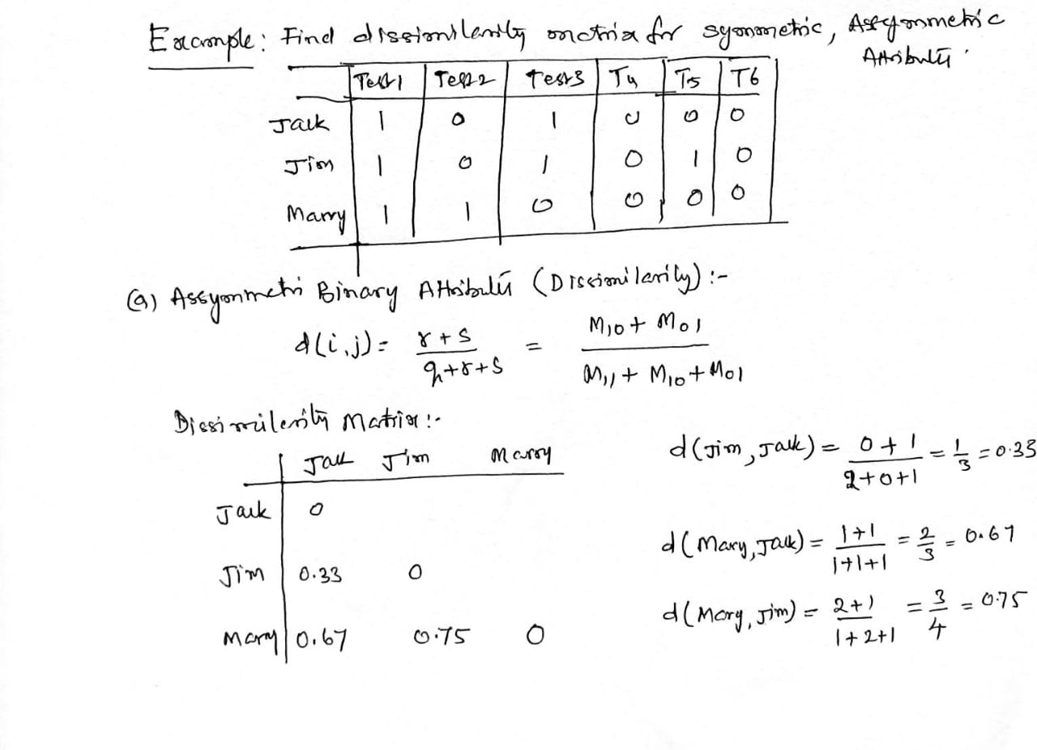
Proximity Measure for Binary Attributes: Example

Slide 17
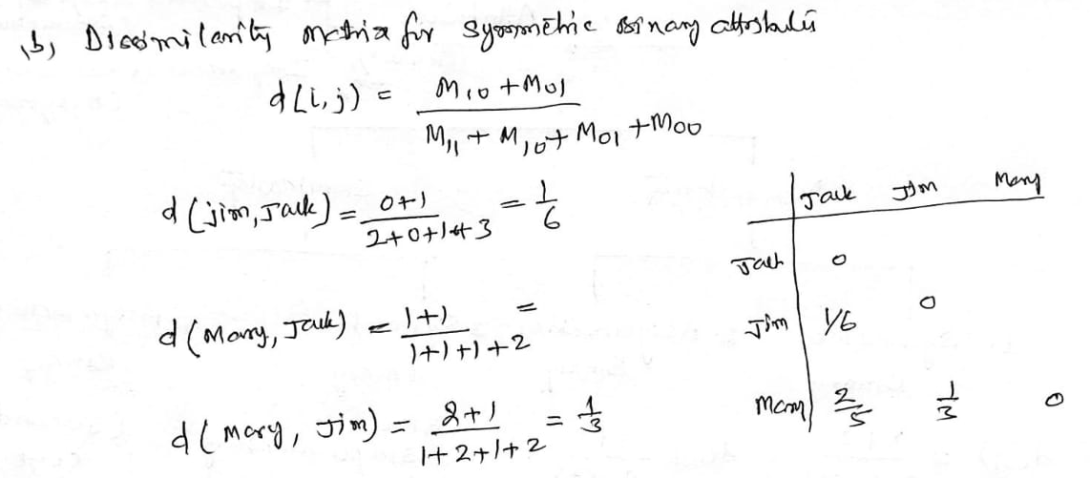
Proximity Measure for Binary Attributes

Slide 18
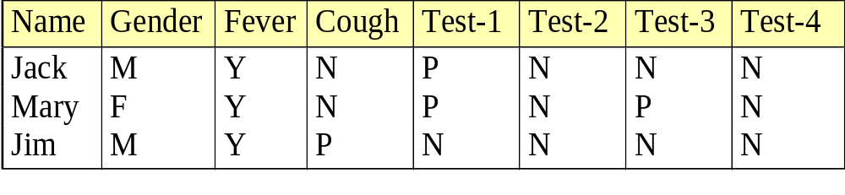
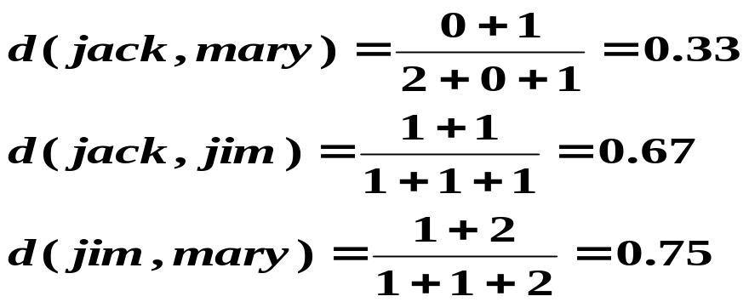
Proximity Measure for Binary Attributes: Example: Find Dissimilarity matrix
Example: Asymmetric dissimilarity matrix for given dataset
  Gender is a symmetric attribute
  The remaining attributes are asymmetric binary
  Let the values Y and P be 1, and the value N 0

Slide 19
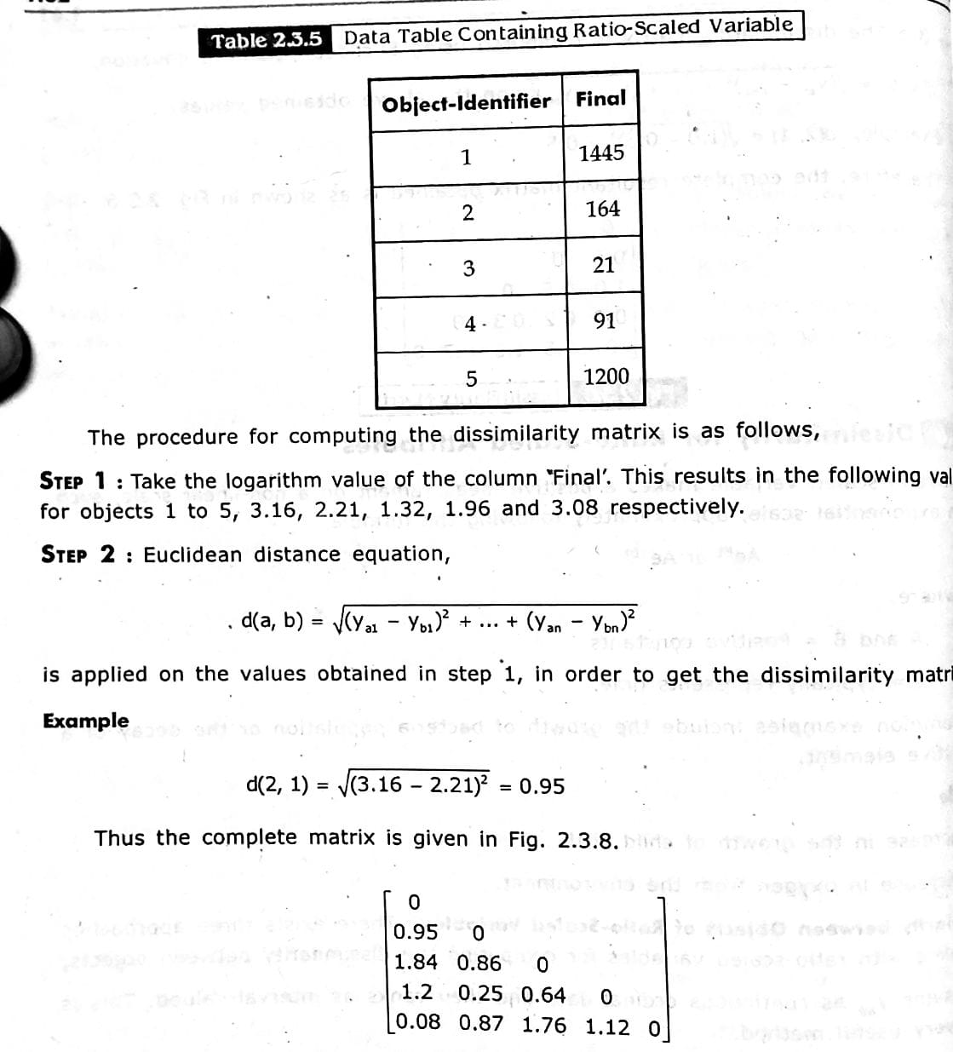
Example: Ratio-Scaled Attributes: Find Dissimilarity matrix

Slide 20

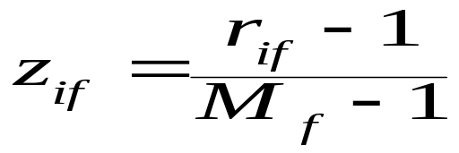
Proximity measure for Ordinal attributes
An ordinal variable can be discrete or continuous
Order is important, e.g., rank
Can be treated like interval-scaled
  replace x_{if} by their rank
  map the range of each variable onto [0, 1] by replacing i-th object in the f-th variable by
  compute the dissimilarity using methods for interval-scaled variables

Slide 21
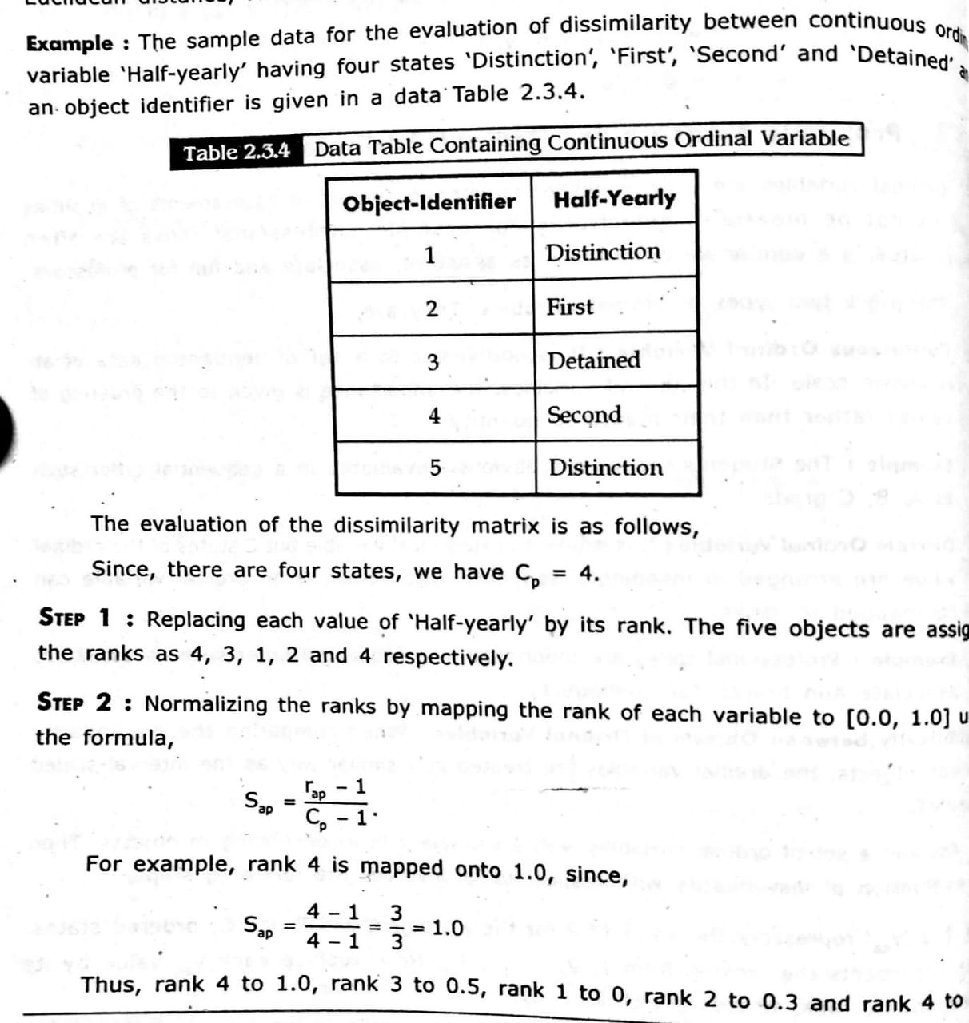
Example: Ordinal Attributes

Slide 22
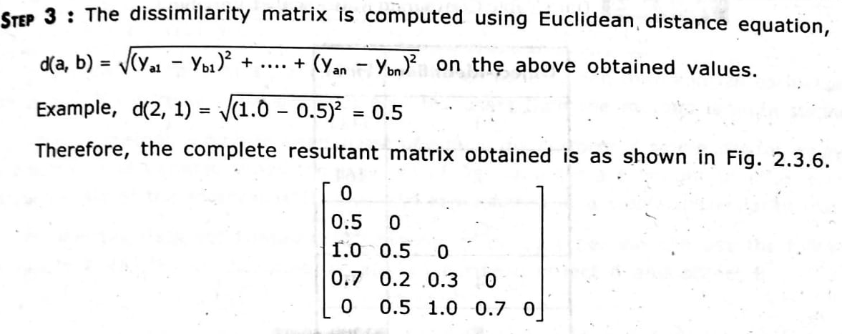
Example: Ordinal Attributes

Slide 23
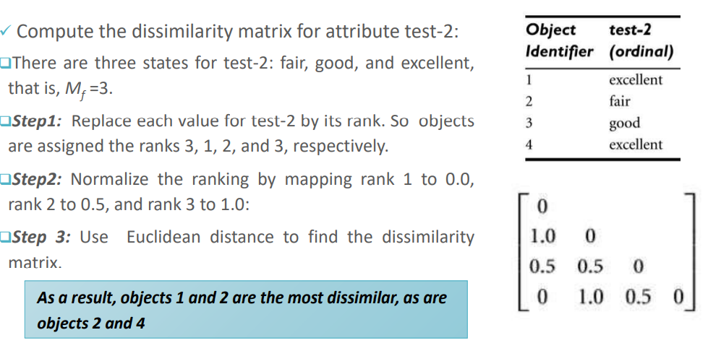
Example: Find Dissimilarity matrix of given ordinal attribute

Slide 24
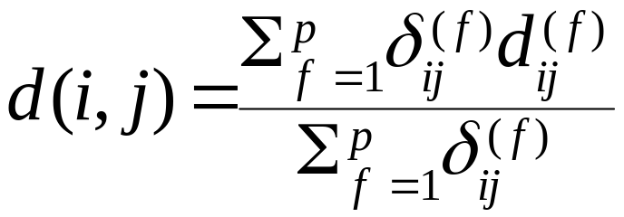
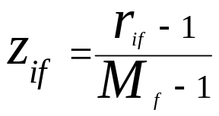
Proximity measures of Mixed Attributes
A database may contain all attribute types
  Nominal, symmetric binary, asymmetric binary, numeric, ordinal
One may use a weighted formula to combine their effects
  f is binary or nominal:
    d_{ij}^{(f)} = 0 if x_{if} = x_{jf} , or d_{ij}^{(f)} = 1 otherwise
  f is numeric: use the normalized distance
  f is ordinal
    Compute ranks r_{if} and
    Treat z_{if} as interval-scaled

Slide 25
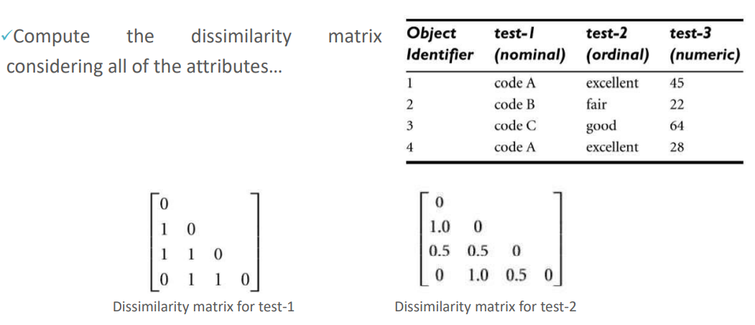
Example: Find Dissimilarity of Mixed Attributes
Nominal attribute
Ordinal attribute

Slide 26
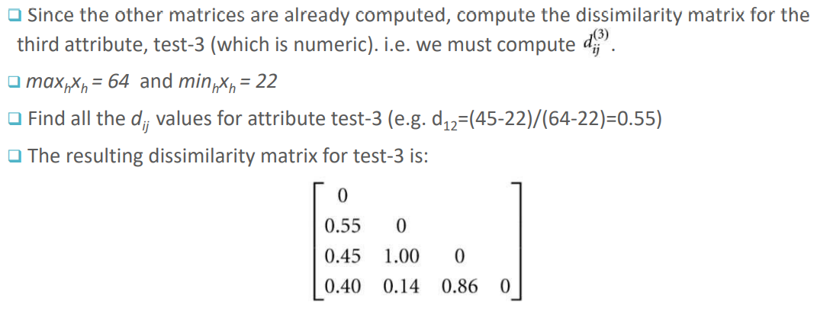
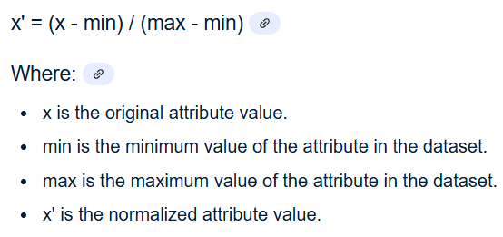
Example: Find Dissimilarity of Mixed Attributes
Numeric Attribute:
Numeric attributes is to normalize the data first, and then use the Manhattan distance. This normalization is useful when the attributes have different scales, and it ensures that attributes with larger values don't dominate the distance calculation. A common normalization method is to scale each attribute to the range using the following formula:

Slide 27
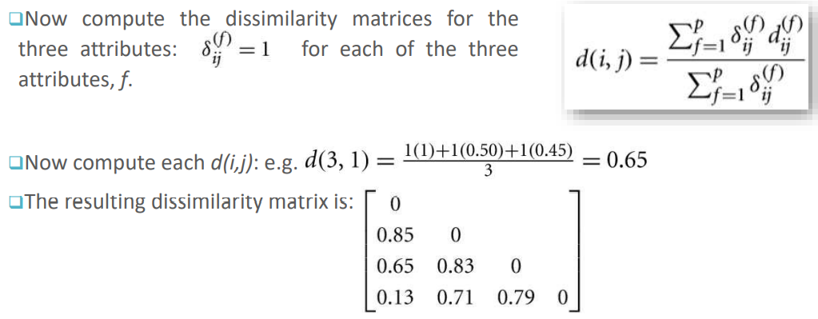
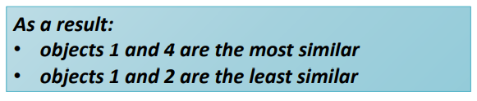
Example: Find Dissimilarity of Mixed Attributes

Slide 28
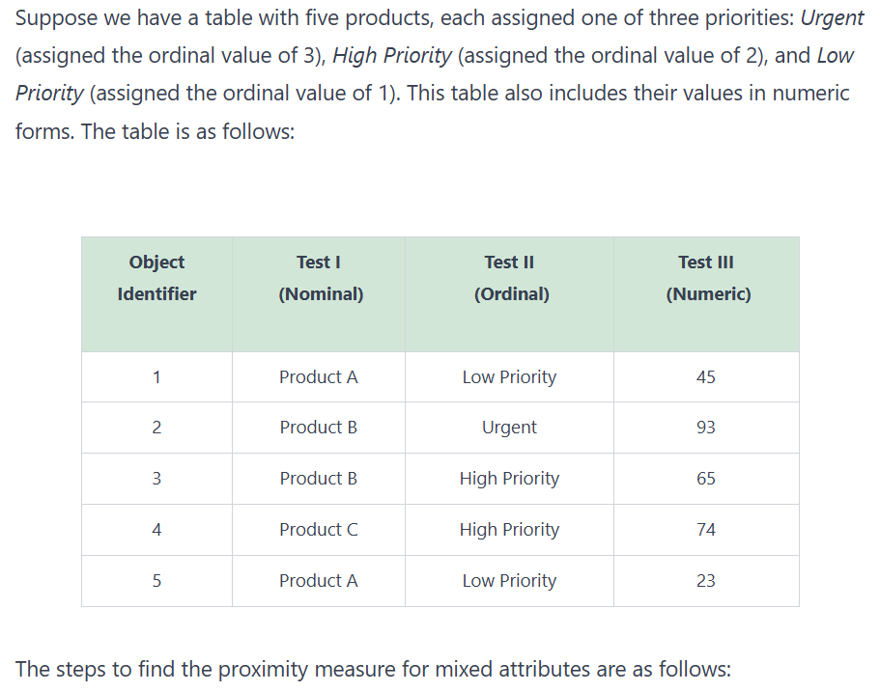
Example: Mixed Attributes

Slide 29
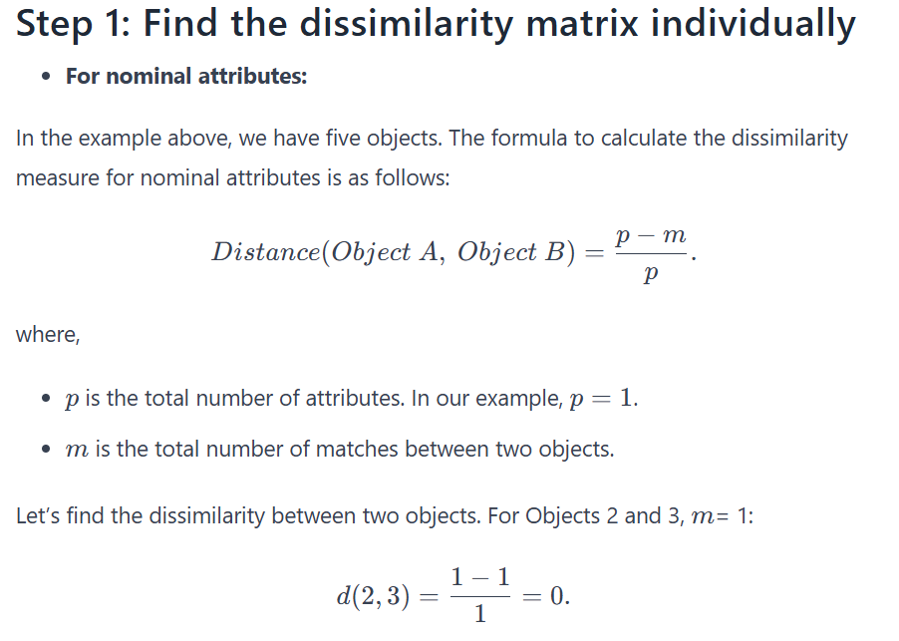
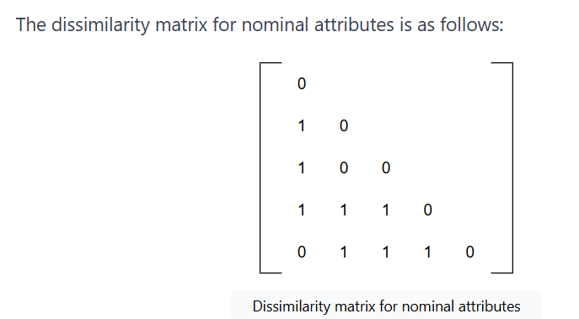
Example: Mixed Attributes

Slide 30
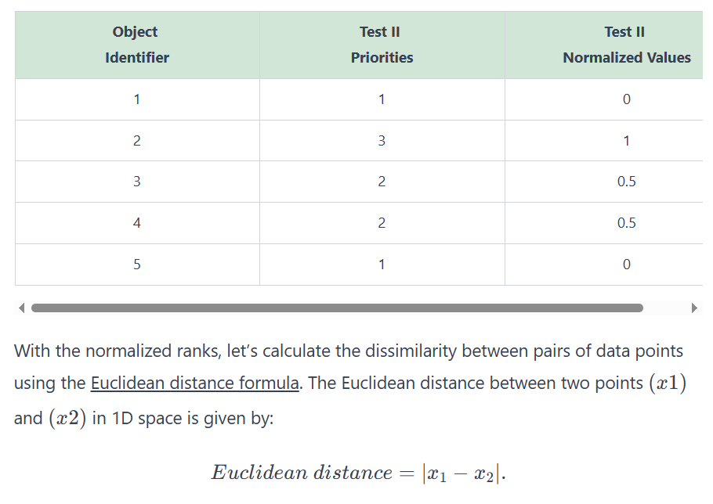
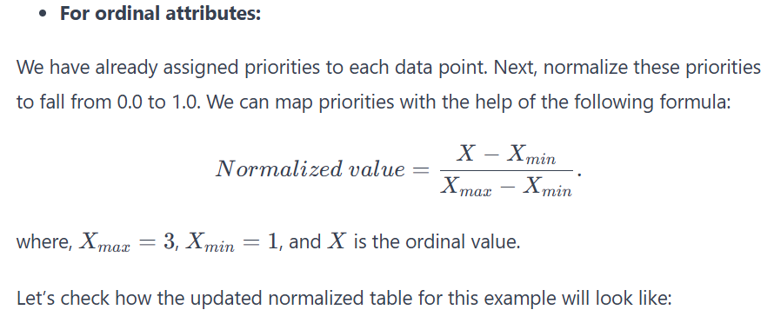
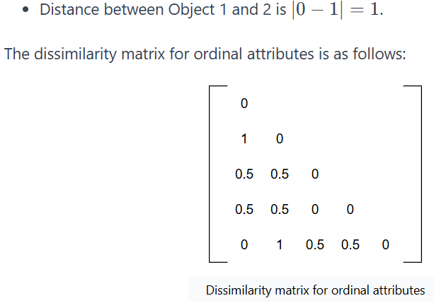
Example: Mixed Attributes

Slide 31
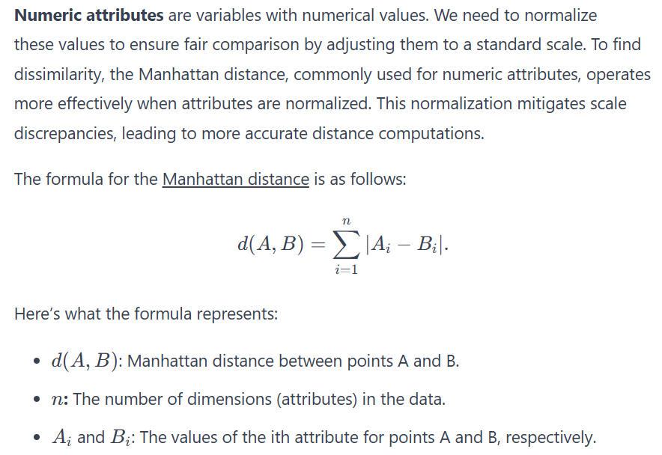
Example: Mixed Attributes

Slide 32
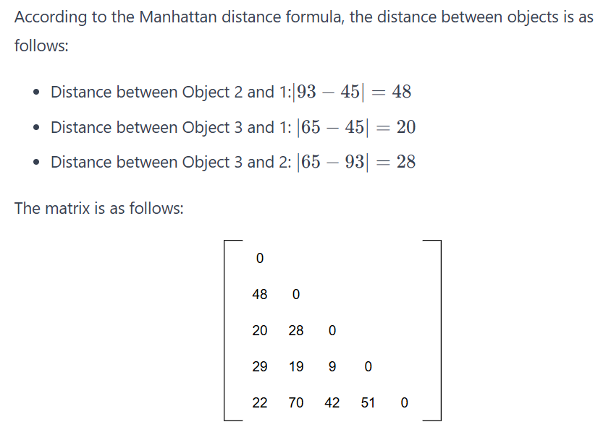
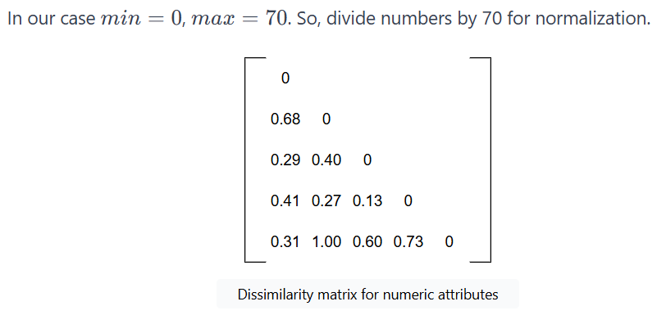
Example: Mixed Attributes

Slide 33
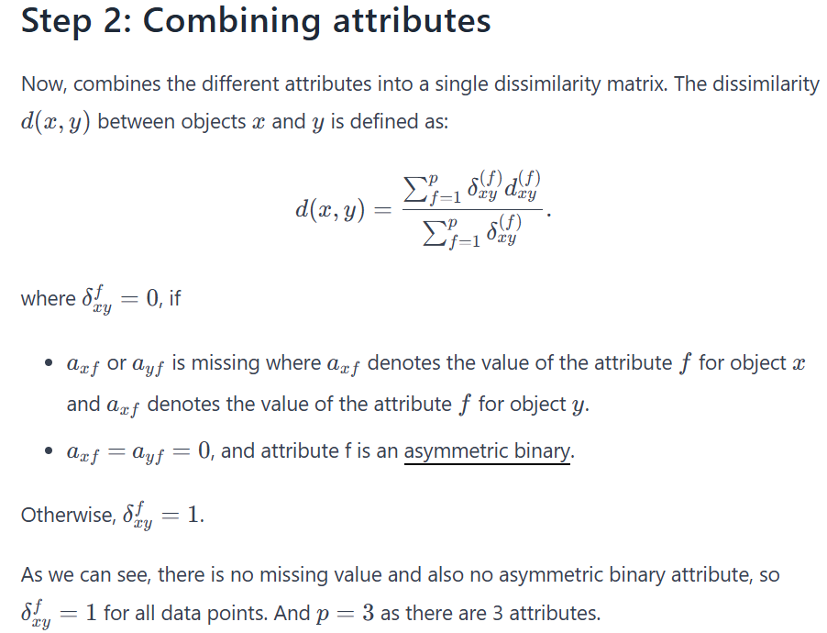
Example: Mixed Attributes

Slide 34
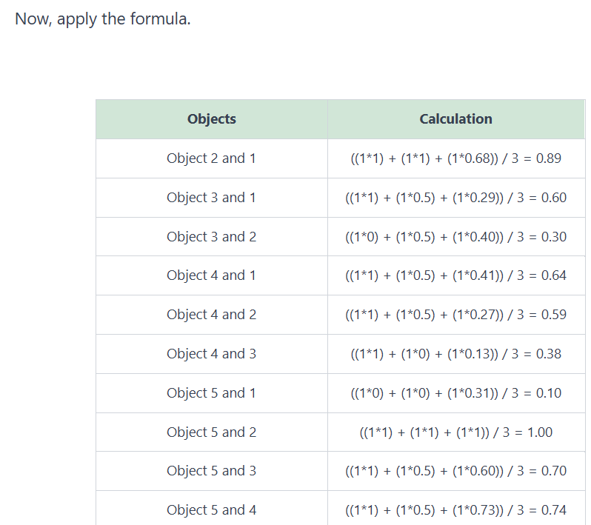
Example: Mixed Attributes

Slide 35

Example: Mixed Attributes

Slide 36

Example: Mixed Attributes

Slide 37

Example : Mixed Attributes

Slide 38

Example: Mixed Attributes

Slide 39

Example: Mixed Attributes

Slide 40

Cosine Similarity
A document can be represented by thousands of attributes, each recording the frequency of a particular word (such as keywords) or phrase in the document.
Other vector objects: gene features in micro-arrays, …
Applications: information retrieval, biologic taxonomy, gene feature mapping, ...
Cosine measure: If d₁ and d₂ are two vectors (e.g., term-frequency vectors), then
cos(d₁, d₂) = (d₁ • d₂) /||d₁|| ||d₂|| ,
  where • indicates vector dot product, ||d||: the length of vector d

Slide 41
Example: Find similarity of documents
cos(d₁, d₂) = (d₁ • d₂) /||d₁|| ||d₂|| ,
  where • indicates vector dot product, ||d|: the length of vector d
Ex: Find the similarity between documents 1 and 2.
  d₁ = (5, 0, 3, 0, 2, 0, 0, 2, 0, 0)
  d₂ = (3, 0, 2, 0, 1, 1, 0, 1, 0, 1)
  d₁•d₂ = 5*3+0*0+3*2+0*0+2*1+0*1+0*1+2*1+0*0+0*1 = 25
  ||d₁||= (5*5+0*0+3*3+0*0+2*2+0*0+0*0+2*2+0*0+0*0)^{0.5}=(42)^{0.5} = 6.481
  ||d₂||= (3*3+0*0+2*2+0*0+1*1+1*1+0*0+1*1+0*0+1*1)^{0.5}=(17)^{0.5} = 4.12
  cos(d₁, d₂ ) = 0.94

